Slide 1
Machine Learning
Lecture 08

Slide 2
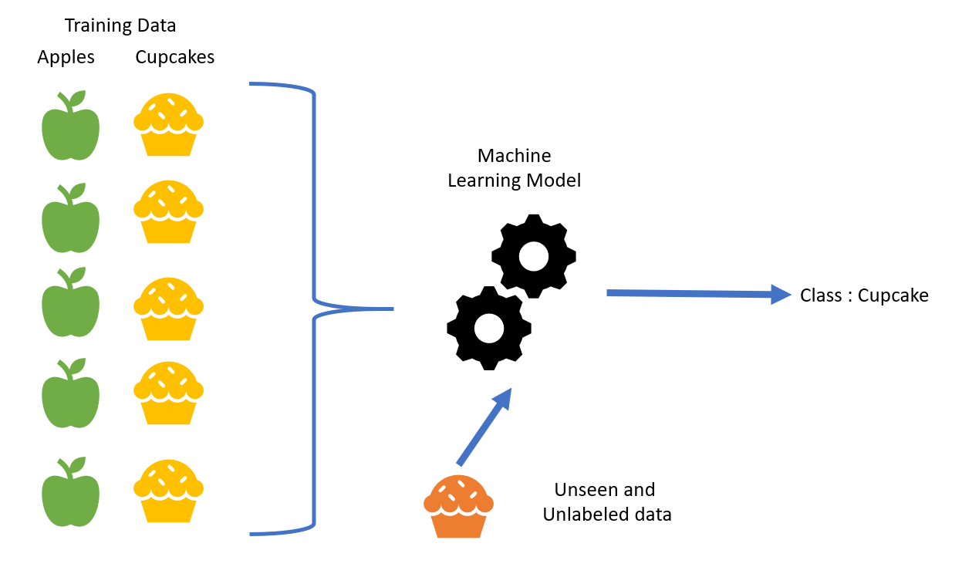

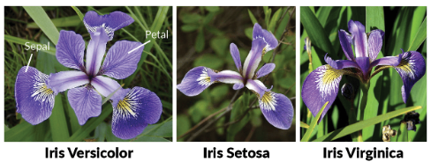
Classification

Slide 3
Classification Algorithms
Classification algorithms are used when the output variable is categorical, which means there are two or more classes.
Algorithms
Logistic Regression
Naïve Bayes
Support vector Machines
Random Forest
Decision Trees

Slide 4
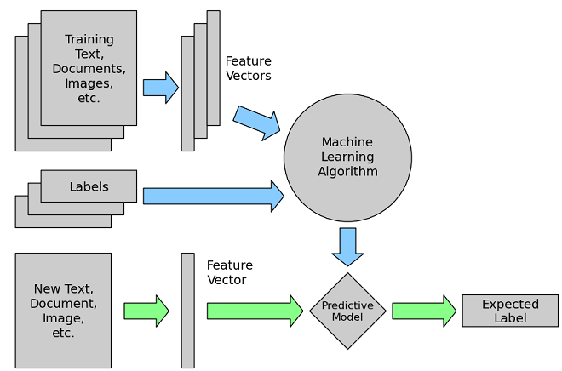


How to Perform Classification
Training Data
Testing Data

Slide 5
Logistic Regression
Source: https://www.coursera.org/learn/machine-learning

Slide 6
Logistic Regression
Supervised Machine Learning algorithm
Binary Classification Algorithm
Don't be confused by the name "Logistic Regression“.
It is named that way for historical reasons and is actually an approach to classification problems, not regression problems
Instead of our output vector y being a continuous range of values, it will only be 0 or 1. y∈{0,1}
Where 0 is usually taken as the "negative class" and 1 as the "positive class", but you are free to assign any representation to it.
One method is to use linear regression and map all predictions greater than 0.5 as a 1 and all less than 0.5 as a 0.
This method doesn't work well because classification is not actually a linear function.

Slide 7

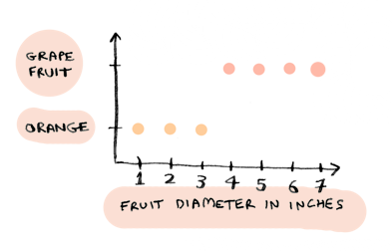
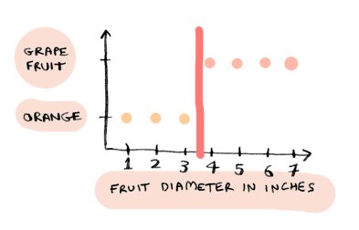
Logistic Regression
Adit.io

Slide 8
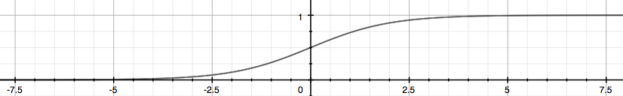

Logistic Regression
Hypothesis function: $y’ = hθ(x) =g(θ0 + θ1x$)
Our hypothesis should satisfy:
0 ≤ hθ​(x) ≤1
Our new form uses the "Sigmoid Function" also called the "Logistic Function”
$hθ(x)$= g (θ^{T}x)
z = θ^{T}x
g(z) = 1 / ( 1+e^{−z} )
z | sig(z)
-2 | 0.12
-1.5 | 0.18
-1 | 0.27
-0.5 | 0.38
0 | 0.50
0.5 | 0.62
1 | 0.73
1.5 | 0.82
2 | 0.88
2.5 | 0.92

Slide 9
Logistic Regression
We start with our old hypothesis (linear regression), except that we want to restrict the range to 0 and 1.
This is accomplished by plugging θ^{T}x into the Logistic Function.
hθ​ will give us the probability that our output is 1.
For example, hθ​(x)=0.7 gives us the probability of 70% that our output is 1.
hθ(x) = P(y=1|x;θ) = 1 − P(y=0|x;θ)
P(y=0|x;θ) + P(y=1|x;θ) = 1
Our probability that our prediction is 0 is just the complement of our probability that it is 1 (e.g. if probability that it is 1 is 70%, then the probability that it is 0 is 30%).

Slide 10
Logistic Regression (Decision Boundary)
In order to get our discrete 0 or 1 classification, we can translate the output of the hypothesis function as follows:
hθ(x) ≥ 0.5 → y = 1
hθ(x) < 0.5 → y = 0
The way our logistic function g behaves is that when its input is greater than or equal to zero, its output is greater than or equal to 0.5:
g(z) ≥ 0.5 when z ≥ 0
So if our input to g is θ^{T}X, then that means:
hθ(x)=g(θ^{T}x) ≥ 0.5 when θ^{T}x ≥ 0
From these statements we can now say:
θ^{T}x ≥ 0 ⇒ y = 1
θ^{T}x < 0 ⇒ y = 0
The decision boundary is the line that separates the area where y = 0 and where y = 1. It is created by our hypothesis function.

Slide 11
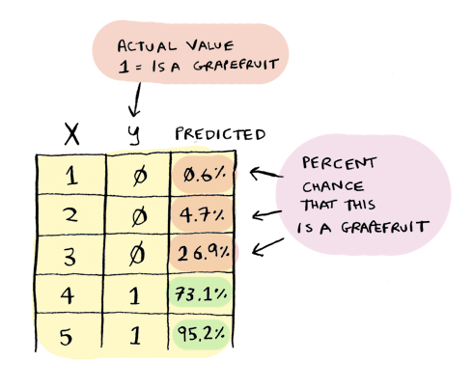
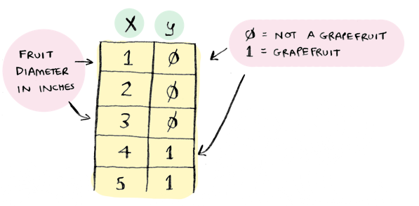
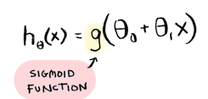
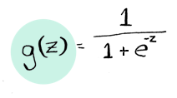
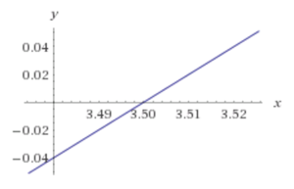
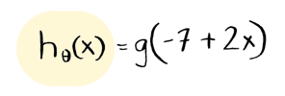
Example

Slide 12

Logistic Regression (Decision Boundary)
Θ = $\left[\begin{matrix}5 \\ −1 \\ 0\end{matrix}\right]$
y=1 if 5+ (−1) * x₁ 0 * x₂ ≥ 0
5− x₁ ≥ 0
−x₁ ≥ − 5
x₁ ≤ 5
In this case, our decision boundary is a straight vertical line placed on the graph where x₁ = 5, and everything to the left of that denotes y = 1, while everything to the right denotes y = 0.
Again, the input to the sigmoid function g(z) (e.g. θ^{T}X) doesn't need to be linear, and could be a function that describes a circle (e.g. z = θ₀​ + θ₁ ​x₁²​ + θ₂​x₂²​) or any shape to fit our data.

Slide 13
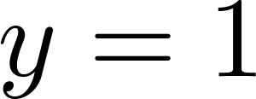

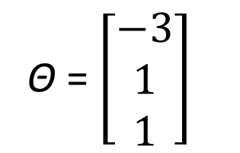
Decision Boundary
Θ = $\left[\begin{matrix}−3 \\ 1 \\ 1\end{matrix}\right]$
x₂
3
2
1
Predict “ “ if
1
2
3
x₁

Slide 14
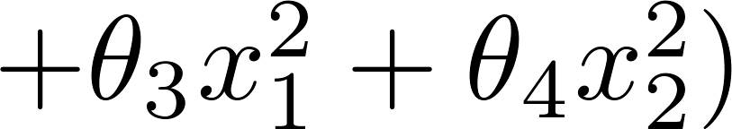
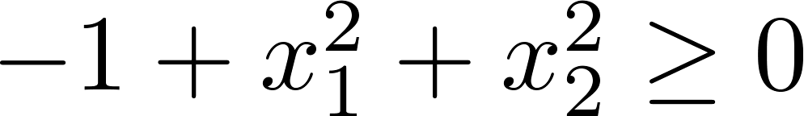
Non-linear decision boundaries
x₂
1
x₁
-1
1
-1
Predict “ “ if
x₂
x₁

Slide 15
Logistic Regression - Recap
Hypothesis function: $y’ = hθ(x) =g(θ0 + θ1x$)
Our hypothesis should satisfy:
0 ≤ hθ​(x) ≤1
Our new form uses the "Sigmoid Function" also called the "Logistic Function”
$hθ(x)$= g (θ^{T}x)
z = θ^{T}x
g(z) = 1 / ( 1+e^{−z} )
z | sig(z)
-2 | 0.12
-1.5 | 0.18
-1 | 0.27
-0.5 | 0.38
0 | 0.50
0.5 | 0.62
1 | 0.73
1.5 | 0.82
2 | 0.88
2.5 | 0.92

Slide 16
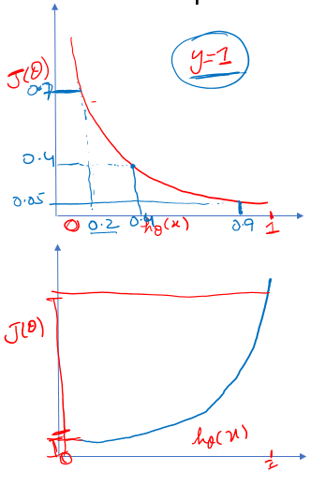


Regression (Cost Function)
Logistic Regression: Cost/Loss Function
The more our hypothesis is off from y, the larger the cost function output. If our hypothesis is equal to y, then our cost is 0:
f(x) | -log(h_{θ}(x)) | -log(1-h_{θ}(x))
0.1 | 1.00 | 0.05
0.2 | 0.70 | 0.10
0.3 | 0.52 | 0.15
0.4 | 0.40 | 0.22
0.5 | 0.30 | 0.30
0.6 | 0.22 | 0.40
0.7 | 0.15 | 0.52
0.8 | 0.10 | 0.70
0.9 | 0.05 | 1.00
Notes:
If our correct answer 'y' is 0, then the cost function will be 0 if our hypothesis function also outputs 0. If our hypothesis approaches 1, then the cost function will approach infinity.
If our correct answer 'y' is 1, then the cost function will be 0 if our hypothesis function outputs 1. If our hypothesis approaches 0, then the cost function will approach infinity.
Note that writing the cost function in this way guarantees that J(θ) is convex for logistic regression.

Slide 17

Logistic Regression (Simplified Cost Function)
We can compress our cost function's two conditional cases into one case:
Cost (hθ​(x), y) = − y log (hθ​ (x)) − (1−y) log (1 − hθ ​(x)).
Notice that when y is equal to 1, then the second term −(1−y) log (1 − hθ​(x)) will be zero and will not affect the result. If y is equal to 0, then the first term − y log (hθ ​(x)) will be zero and will not affect the result.
We can fully write out our entire cost function as follows:
$J\left(θ\right)= \frac{−1}{m}\sum_{i=1}^{m}{[y^{i}\log{({y′}^{i})}+{(1− y}^{i})\log{{(1−y′}^{i})}]}$

Slide 18



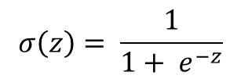
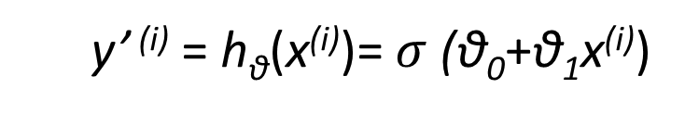
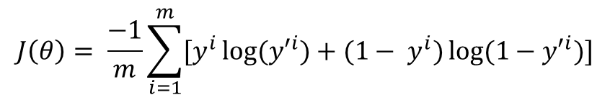
Logistic Regression (Gradient Descent)
Repeat{
θ_{j} := θ_{j} − α $\frac{\text{∂}}{\text{∂}\text{θ}\text{j}}$ L(θ)
}
y’ ^{(i)} = h_{θ}(x^{(i)})= $σ$(θ₀+θ₁x^{(i)})
$$σ\left(z\right)= \frac{1}{1+ e^{−z}}$$
$$J\left(θ\right)= \frac{−1}{m}\sum_{i=1}^{m}{[y^{i}\log{({y′}^{i})}+{(1− y}^{i})\log{{(1−y′}^{i})}]}$$
$σ\left(z\right)′$ = $σ\left(z\right) \left(1 −σ\left(z\right)\right)$

Slide 19
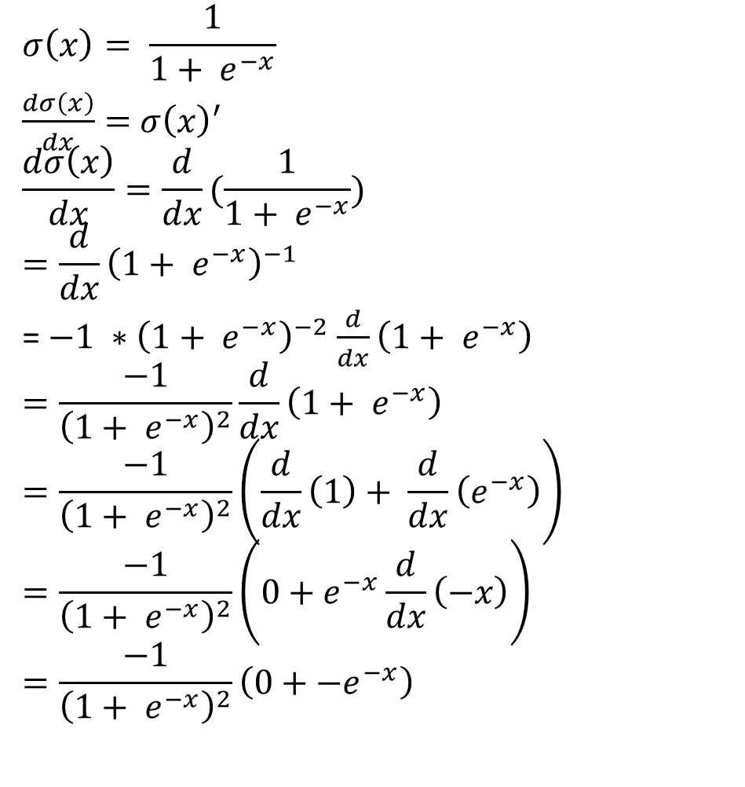

Sigmoid Derivation
$$σ\left(x\right)= \frac{1}{1+ e^{−x}}$$
$\frac{dσ\left(x\right)}{dx}=$ $σ\left(x\right)′$
$$\frac{dσ\left(x\right)}{dx}=\frac{d}{dx}(\frac{1}{1+ e^{−x}})$$
$$=\frac{d}{dx}{\left(1+ e^{−x}\right)}^{−1}$$
= $−1 ∗{\left(1+ e^{−x}\right)}^{−2}$ $\frac{d}{dx}\left(1+ e^{−x}\right)$
$$=\frac{−1}{{\left(1+ e^{−x}\right)}^{2}}\frac{d}{dx}\left(1+ e^{−x}\right)$$
$$=\frac{−1}{{\left(1+ e^{−x}\right)}^{2}}\left(\frac{d}{dx}\left(1\right)+ \frac{d}{dx}\left(e^{−x}\right)\right)$$
$$=\frac{−1}{{\left(1+ e^{−x}\right)}^{2}}\left(0+e^{−x}\frac{d}{dx}\left(−x\right)\right)$$
$$=\frac{−1}{{\left(1+ e^{−x}\right)}^{2}}\left(0+{−e}^{−x}\right)$$
$$=\frac{e^{−x}}{{\left(1+ e^{−x}\right)}^{2}}$$
$$=(\frac{1}{1+ e^{−x}})(\frac{e^{−x}}{1+ e^{−x}})$$
$$=σ\left(x\right) \left(\frac{e^{−x}}{1+ e^{−x}}\right)$$
$$=σ\left(x\right) \left(\frac{1 −1+ e^{−x}}{1+ e^{−x}}\right)$$
$$=σ\left(x\right) \left(\frac{1+ e^{−x}−1}{1+ e^{−x}}\right)$$
$$=σ\left(x\right) \left(\frac{1 + e^{−x}}{1+ e^{−x}} −\frac{1 }{1+ e^{−x}}\right)$$
$$=σ\left(x\right) \left(1 −σ\left(x\right)\right)$$
https://medium.com/analytics-vidhya/derivative-of-log-loss-function-for-logistic-regression-9b832f025c2d
Notes:
https://eli.thegreenplace.net/2016/the-softmax-function-and-its-derivative/

Slide 20
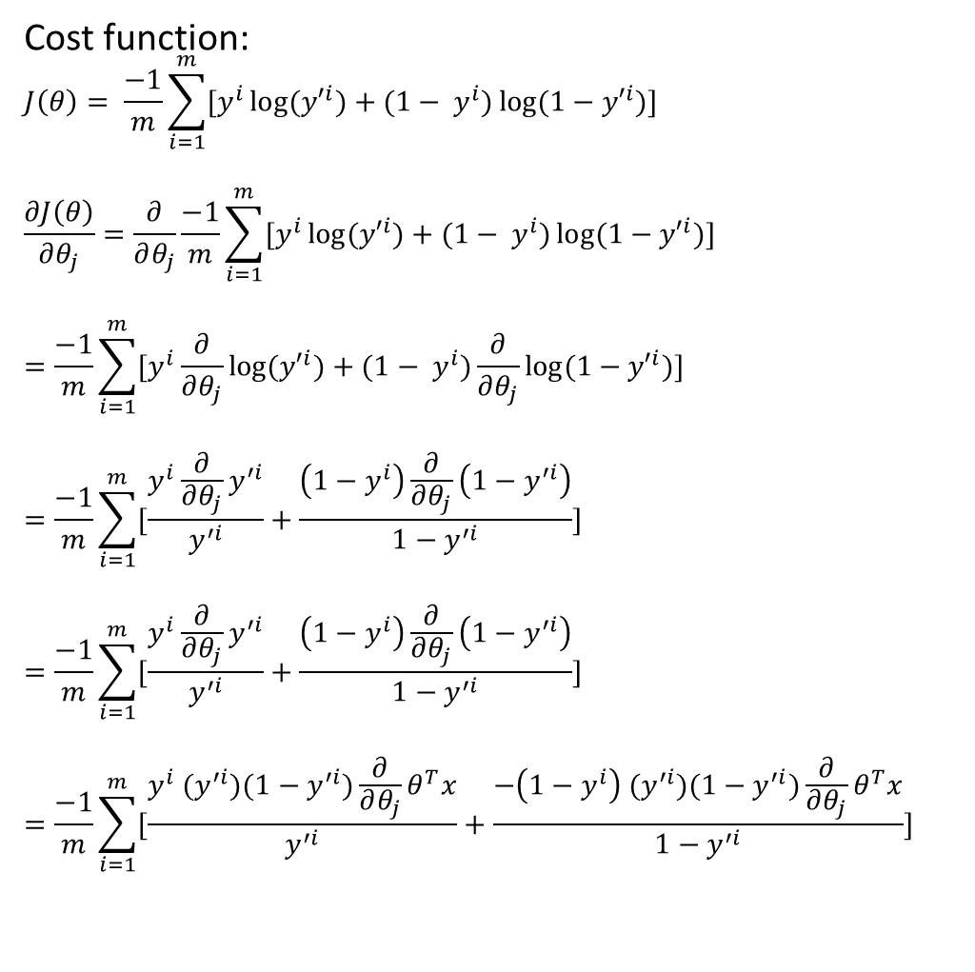
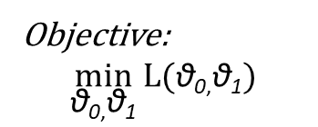

Binary Cross Entropy
Cost function:
$$J\left(θ\right)= \frac{−1}{m}\sum_{i=1}^{m}{[y^{i}\log{({y′}^{i})}+{(1− y}^{i})\log{{(1−y′}^{i})}]}$$
$$\frac{∂J\left(θ\right)}{∂θ_{j}}=\frac{∂}{∂θ_{j}}\frac{−1}{m}\sum_{i=1}^{m}{[y^{i}\log{({y′}^{i})}+{(1− y}^{i})\log{{(1−y′}^{i})}]}$$
$$=\frac{−1}{m}\sum_{i=1}^{m}{[y^{i}\frac{∂}{∂θ_{j}}\log{({y′}^{i})}+{(1− y}^{i})\frac{∂}{∂θ_{j}}\log{{(1−y′}^{i})}]}$$
$$=\frac{−1}{m}\sum_{i=1}^{m}{[\frac{y^{i}\frac{∂}{∂θ_{j}}y^{′i}}{y^{′i}}+\frac{\left(1−y^{i}\right)\frac{∂}{∂θ_{j}}\left(1−y^{′i}\right)}{1−y^{′i}}]}$$
$$=\frac{−1}{m}\sum_{i=1}^{m}{[\frac{y^{i}\frac{∂}{∂θ_{j}}y^{′i}}{y^{′i}}+\frac{\left(1−y^{i}\right)\frac{∂}{∂θ_{j}}\left(1−y^{′i}\right)}{1−y^{′i}}]}$$
$$=\frac{−1}{m}\sum_{i=1}^{m}{[\frac{y^{i}{ (y}^{′i})(1−y^{′i})\frac{∂}{∂θ_{j}}θ^{T}x}{y^{′i}}+\frac{−\left(1−y^{i}\right){ (y}^{′i})(1−y^{′i})\frac{∂}{∂θ_{j}}θ^{T}x}{1−y^{′i}}]}$$
Objective:
$$\min_{\text{θ}\text{0}\text{,}\text{θ}\text{1}}{L(\text{θ}\text{0}\text{,}\text{θ}\text{1})}$$
Hypothesis Function:
y’ ^{(i)} = h_{θ}(x^{(i)})= $σ$(θ₀+θ₁x^{(i)})
$$=\frac{−1}{m}\sum_{i=1}^{m}{[\frac{y^{i}{ (y}^{′i})(1−y^{′i})\frac{∂}{∂θ_{j}}θ^{T}x}{y^{′i}}−\frac{\left(1−y^{i}\right){ (y}^{′i})(1−y^{′i})\frac{∂}{∂θ_{j}}θ^{T}x}{1−y^{′i}}]}$$
$$=\frac{−1}{m}\sum_{i=1}^{m}{[y^{i}\left(1−y^{′i}\right)x_{j}^{i}−{(1− y}^{i})y^{′i}x_{j}^{i}]}$$
$$=\frac{−1}{m}\sum_{i=1}^{m}{[y^{i}\left(1−y^{′i}\right)−{(1− y}^{i})y^{′i}]x_{j}^{i}}$$
$$=\frac{−1}{m}\sum_{i=1}^{m}{[y^{i}−y^{i}y^{′i} −{y^{′i}+ y}^{i}y^{′i}]x_{j}^{i}}$$
$$=\frac{−1}{m}\sum_{i=1}^{m}{[y^{i} −y^{′i}]x_{j}^{i}}$$
$$=\frac{1}{m}\sum_{i=1}^{m}{[y^{′i} −y^{i}]x_{j}^{i}}$$

Slide 21


Logistic Regression (Gradient Descent)
$\text{θ}\text{j} ≔\text{θ}\text{j} \text{−} \text{α} (\frac{1}{m}\sum_{i=1}^{m}{{(f(x}^{\left(i\right)}) − y^{ \left(i\right)} ) }{x_{j}^{(i)}}^{ })$
where ${f(x}^{\left(i\right)})=σ{(x}^{\left(i\right)})$
Repeat until converge
{
$\text{θ}\text{0} ≔\text{θ}\text{0} \text{−} \text{α} (\frac{1}{m}\sum_{i=1}^{m}{(f{(x}^{\left(i\right)}) − y^{ \left(i\right)} )}$ ${x_{0}^{(i)}}^{ })$
$\text{θ}\text{1} ≔\text{θ}\text{1} \text{−} \text{α} (\frac{1}{m}\sum_{i=1}^{m}{(f{(x}^{\left(i\right)}) − y^{ \left(i\right)} )}$ ${x_{1}^{(i)}}^{ })$
…
}

